Slide 1

CSET 150
Network Design and Management
Evening Masters Edition
Dr. Mahboob Qaosar
Associate Professor, CSE, RU

Slide 2
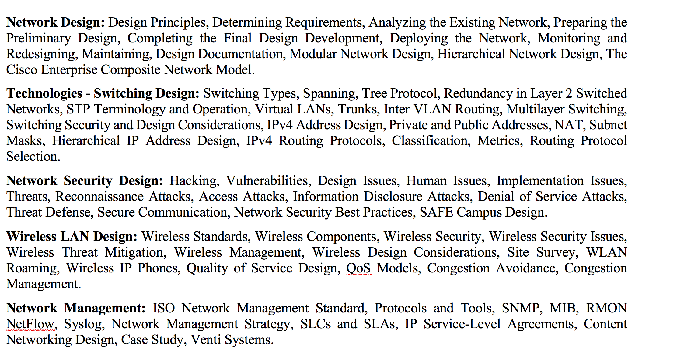
Course Contents

Slide 3
Mitigating Technologies
Known threats can usually be mitigated by security equipment and sound security policies.
Mitigation techniques which are grouped in these four major categories:
Threat defense
Secure communication
Trust and identity
Network security best practices

Slide 4
Threat Defense
… refers to the activities that are necessary to guard against known and unknown attacks, specifically by doing the following:
Defending the edge (border)
Protecting the interior (core)
Guarding the end points

Slide 5
Threat Defense
To do so, the campus design should include the following:
Virus protection
Traffic filtering
Intrusion detection and prevention
Content filtering

Slide 6
Mitigating Technologies
Mitigating Technologies
Threat Defense
Virus protection

Slide 7
Virus protection
… … up-to-date virus protection.
Virus scanning can be performed at :
Hosts: Workstations and servers.
E-mail servers: Incoming messages are scanned prior to being passed to the recipient.
Network: An intrusion detection system (IDS) or intrusion prevention system (IPS),
N.B.: recommendation – different brand antivirus @ different junction.

Slide 8
Mitigating Technologies
Mitigating Technologies
Threat Defense
Virus protection
Traffic filtering

Slide 9
Traffic filtering
Traffic filtering can be achieved at many layers of the OSI model.
It can be done at the data link layer using the Media Access Control (MAC) address
But is most commonly done at the network layer through packet filtering.
Packet filtering is further divided into the following areas:
Static packet filtering
Dynamic packet filtering

Slide 10
Static Packet Filtering
…also known as stateless packet filtering or stateless firewalling.
It is often performed at the perimeter router, which acts as the logical point of demarcation between the ISP and the corporate network.
With stateless firewalling, the router does not track the state of packets and does not know whether a packet is part of the SYN process, the actual transmission, or the FIN process.
A stateless firewall typically tracks only IP addresses and therefore can be tricked by a hacker who spoofs IP addresses.

Slide 11
Dynamic Packet Filtering
… also referred to as Stateful firewalling.
It is usually done by a firewall, which is a dedicated appliance that performs packet scans.
The default behavior of a firewall is that outgoing traffic, traffic that flows from the inside network to the outside network is allowed to leave and its reply traffic is allowed back in.
However, traffic that originates from the outside network and attempts to come to the inside network is automatically denied.

Slide 12
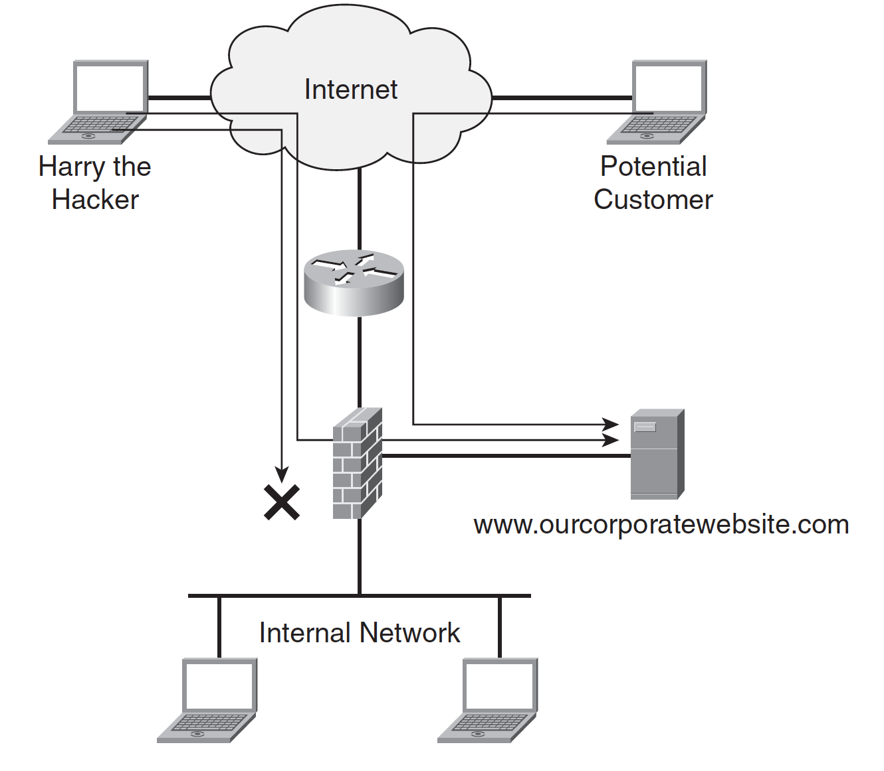
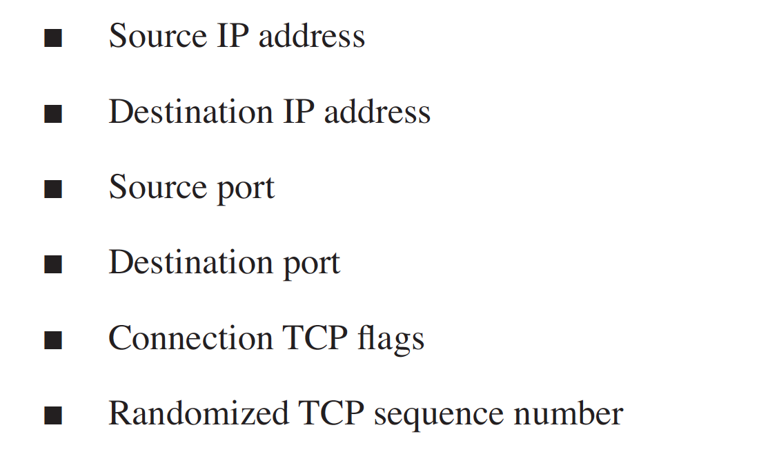
Dynamic Packet Filtering
Demilitarized zone (DMZ)

Slide 13
Mitigating Technologies
Mitigating Technologies
Threat Defense
Virus protection
Traffic filtering
Intrusion detection and prevention

Slide 14
Intrusion Detection & Prevention
INTRUSION – interruption
An IDS watches for:
Attack signatures, such as DoS and virus patterns
Traffic anomalies, such as the same source sending countless requests to SYN on a specific target
Protocol anomalies, such as a malformed packet
An IDS can be one of the following:
Network-based IDS (NIDS) A dedicated appliance installed on the network
Host-based IDS (HIDS) Integrated software on a mission-critical system

Slide 15
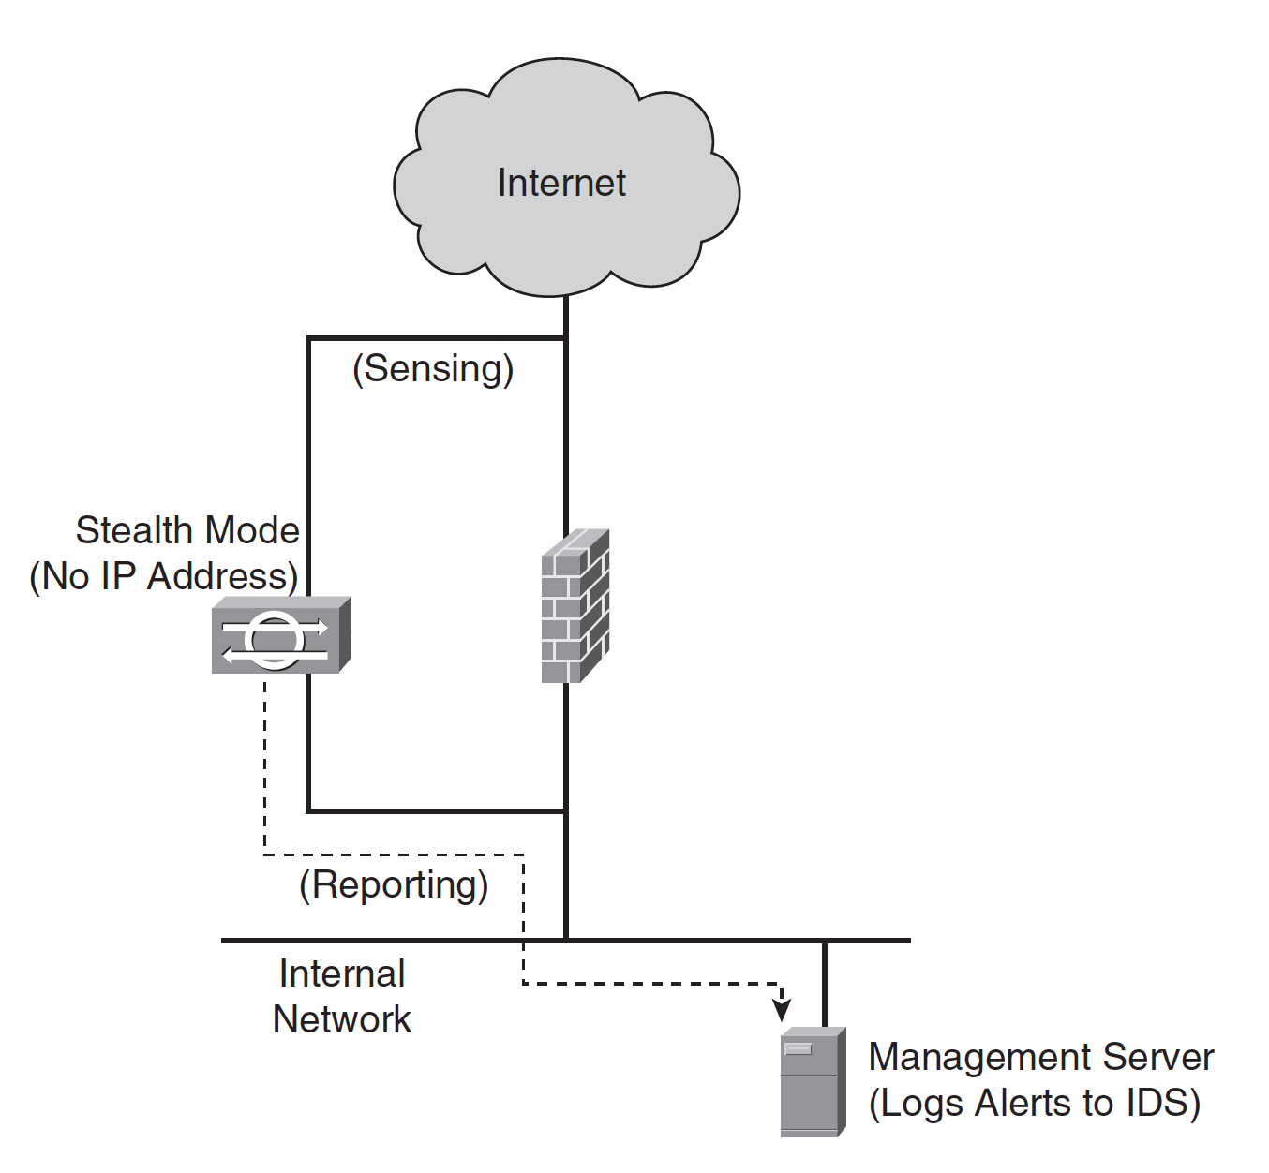
Intrusion Detection & Prevention
Network-Based IDSs:
NIDS
Host-Based IDSs (HIDS)
Mission critical stage
Notes:
Host-Based IDSs
HIDSs are typically installed on mission-critical devices, such as web servers and e-mail servers, but can also be installed on desktop and laptop PCs. Cisco offers an HIDS solution called the Cisco Secure Agent (CSA).
CSA closely monitors the behavior of codes that are coming to the end point and prevents attacks while reporting the incident to the management server.

Slide 16
Intrusion Detection & Prevention
Intrusion Prevention Systems
Upon discovering malicious activity, the IPS can take at least one of the following actions:
Alert the management console server
Send a TCP reset (RST) to the source
Shun the source of the attack by sending a command to the firewall requesting it to temporarily block the suspect IP address.
Currently, only subtle differences exist between IDSs and IPSs; therefore, many vendors interchange the terms.

Slide 17
Mitigating Technologies
Mitigating Technologies
Threat Defense
Virus protection
Traffic filtering
Intrusion detection and prevention
Content filtering

Slide 18
Content Filtering
Uniform resource locator (URL) filtering
Corporations use content filtering to enforce their Internet usage policies, hoping to protect themselves from possible legal implications should their employees visit objectionable websites
E-mail filtering
When designing your corporate e-mail services, consider including an e-mail filtering service. That service, installed on the same network segment as your mail server (usually in a DMZ), sanitizes the e-mail from malware and some executable attachments prior to delivery of the messages to the end user

Slide 19
Mitigating Technologies
Mitigating Technologies
Threat Defense
Virus protection
Traffic filtering
Intrusion detection and prevention
Content filtering

Slide 20
Mitigating Technologies
Mitigating Technologies
Threat Defense
Secure communication
Trust and identity
Network security best practices

Slide 21
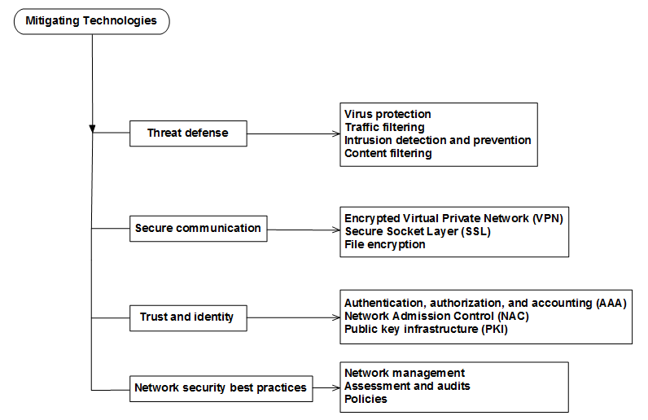

Slide 22
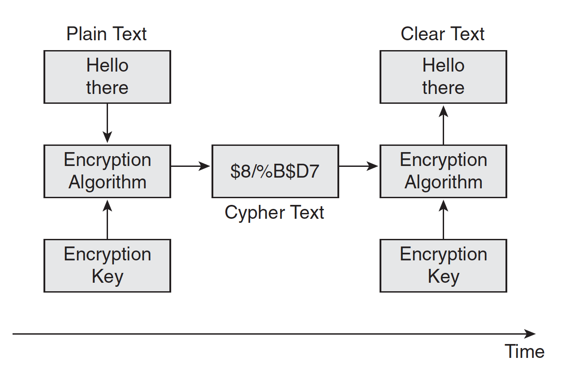
Secure communication
The following are the two types of encryption keys:
Symmetrical keys The same key encrypts and decrypts a message.
Asymmetrical keys A different key decrypts a message from the key that encrypted the message. This is the case with public and private keys.

Slide 23
Secure communication
As part of network design activities, you might consider using one of the following common encryption scenarios:
Encrypted VPN
SSL
File encryption

Slide 24
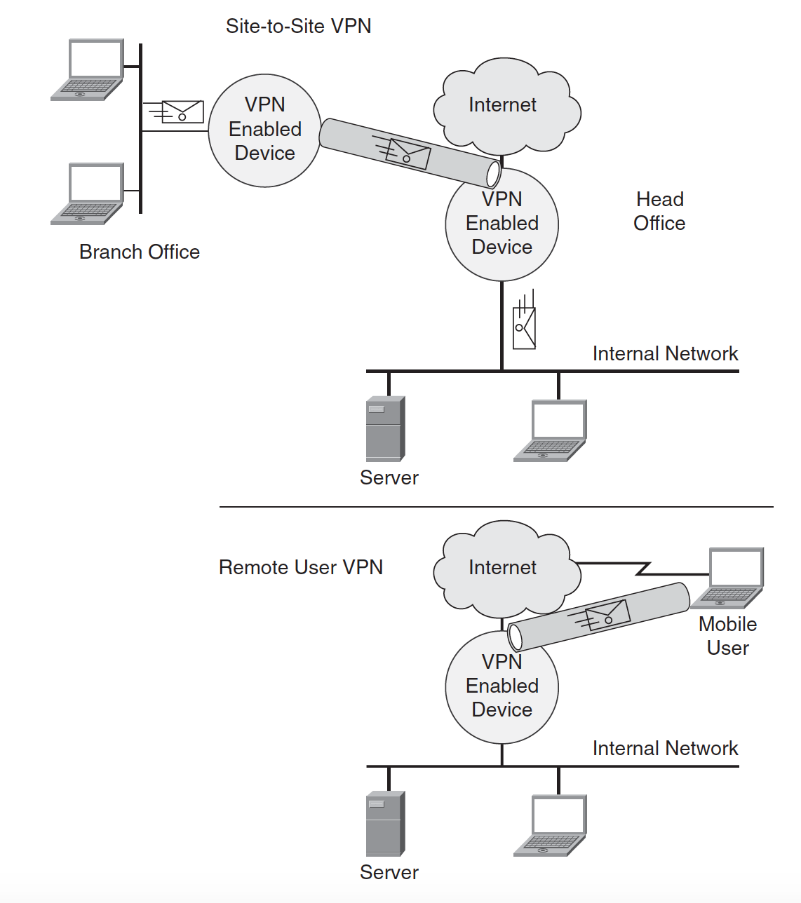
Encrypted VPN

Slide 25
SSL & File Encryption
SSL
SSL provides encryption of data to and from a web browser and could be included in a network design if a point-to-point encryption is needed for a service.
File Encryption
In the case where a document requires confidentiality but the communication might be in clear text, a person can use file-encryption software such as Pretty Good Privacy (PGP) to encrypt the file. The encrypted file must be unencrypted by the reader after it is received.

Slide 26
Mitigating Technologies
Mitigating Technologies
Threat Defense
Secure communication
Trust and identity
Network security best practices

Slide 27
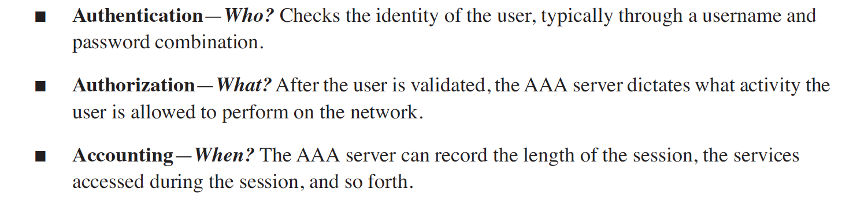
Trust and identity
Trust and identity management includes the following:
Authentication, authorization, and accounting capabilities (AAA)
Network Admission Control (NAC)

Slide 28
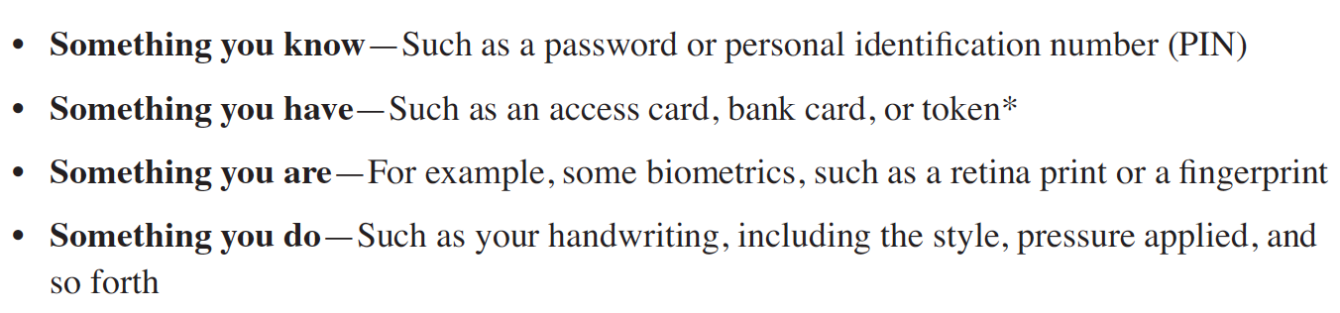
Trust and identity
Strong authentication refers to the two-factor authentication method. The users are authenticated using two of the following factors:

Slide 29
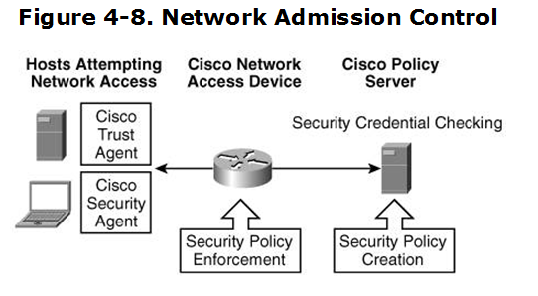
NETWORK ADMISSION CONTROL
Network Admission Control ⇨ NAC
NAC ensures that users and their computers comply with corporate network policies.

